Slide 1
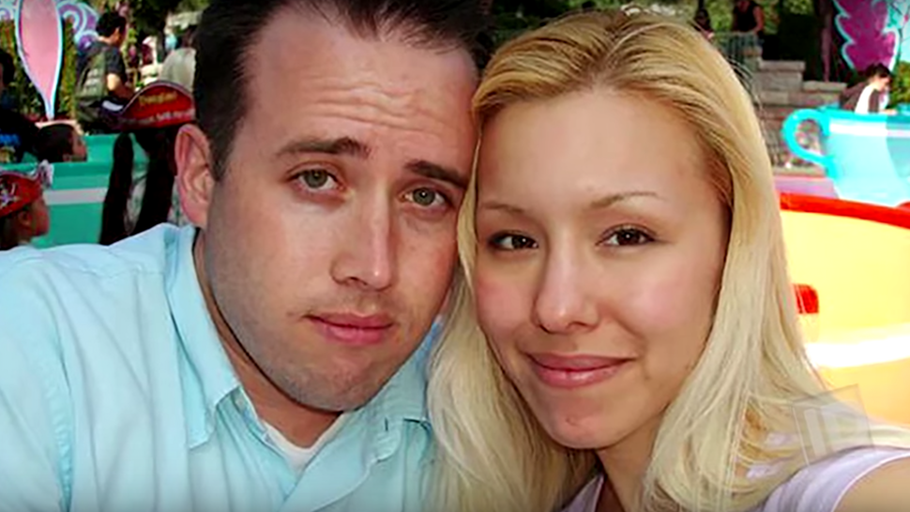
Jodi Arias Crime Case
Name

Slide 2
Background of the case
Jodi Ann Arias was born on July 9, 1980, in the United States.
She was found guilty for killing Travis Victor Alexander on June 4, 2008.
Alexander was born was thirty years old at the time of his death.
Jodi Arias and Alexander first met in September 2006 in Las Vegas.
The two began dating in February 2007 where they had a long distance relationship for over one year.
Despite their friendship, Alexander’s friends had a negative opinion on Jodi Arias.

Slide 3
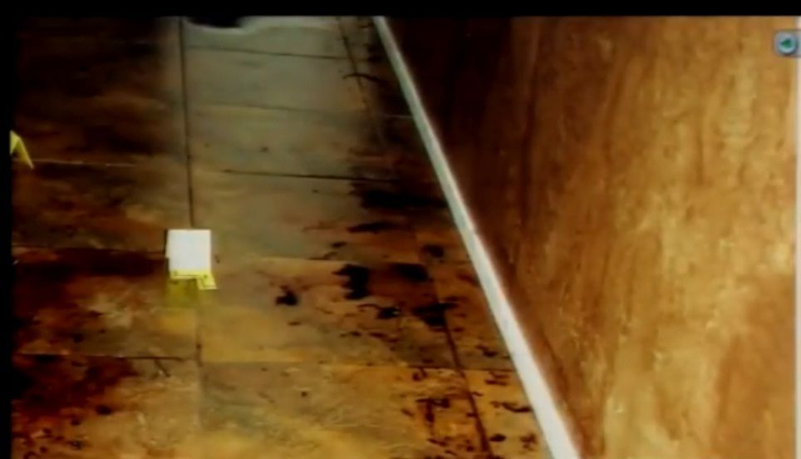
Murder
Alexander was murdered on June 4, 2008.
He had around twenty-nine stab wounds, and his throat was slit.
The body examination revealed that he was also shot on the head.
Kevin Horn, a medical examiner, also stated that Alexander had some wounds on his hands, which was a sign that he tried to defend himself.
The medical professional also said that the victim was probably shot when he was already dead.
His death was termed as a homicide.

Slide 4
Discovery
Alexander had previously told his friends that Arias would accompany him to Mexico for a job-related trip.
Later, he changed his companion to a different person, who was his female friend.
In May 2008, robbery was reported at the residence of Arias’s grandparents home.
The case was significant because a shell casing of a pistol from the incidence was later found next to Alexander’s body (Sarteschi, 2017).
The investigators discovered that on June 2, Arias and Alexander have frequent phone calls, though the recording of their communication was not presented in the court.

Slide 5
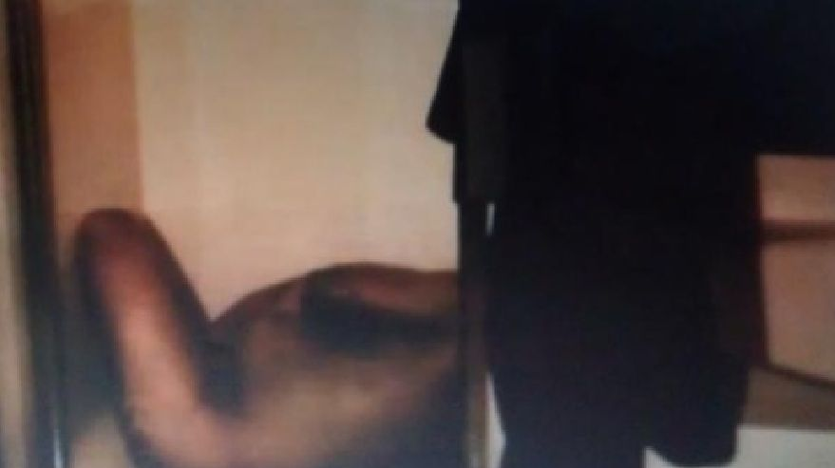
Discovered chain of events
Investigations revealed that Arias rented a vehicle from Budget Rent a Car on June 2.
Her friends stated that she visited them on her way to Utah for a conference.
On June 4, Alexander failed to attend an important meeting.
Burns, who later met Arias stated that he noticed changes in Arias.
One of the changes was the color of her hair and had some cuts on his hands.
Later, Arias returned the rented car on June 7, and the firm confirmed that the vehicle had been driven about forty-five hundred kilometers.

Slide 6
Discoveries
The clerk from the car rental firm stated that when Arias returned the car, some floor mats were missing.
Unfortunately, the issue of the missing floor mats was not followed up because the car was washed before police examined it.
Alexander’s friends were unable to reach him as from June 9.
The friends later found the key to his bedroom and decided to open and check whether he was in.
His friends found a pool of blood in the master bedroom.
Alexander’s body was found in the shower.

Slide 7

Identifying the suspect
The dispatcher questioned Alexander’s friends to find out if he had suicidal thoughts, but they confirmed he had been fine.
Alexander’s friends mentioned Arias as the main suspect.
They said that Alexander had earlier told them that Arias was stalking him in the social media.
The police then found a digital camera damaged inside a washing machine.
Upon viewing the stored recordings, police found some images which proved that Arias and Alexander were together.

Slide 8
Pre-trial
On May 18, the court asked Arias to submit to competency testing.
Early 2011, a defense filing showed the efforts by Arias’ attorney obtaining text messages.
Initially, the defense had told the attorney that there were no text messages available.
The court later ordered the search of any important messages for enough evidence.
In 2009, about eight thousand messages were turned over to the defense.

Slide 9
Trial
The case was handled by the Superior Court of the State of Arizona.
The final decision was made on May 7, 2013.
The verdict provided that Arias was guilty of premeditated murder.
The case history shows that Arias was sentenced to life imprisonment.
Judge Stephen ruled out that the decision was free and fair.
Arias later confessed about the abusive relationship she had with Alexander (Link, 2018).
She said that the incidence happened as she was trying to defend herself from the violent Alexander.

Slide 10
References
Link, J. (2018). Constructing Casey Anthony & Jodi Arias. Metamorphosis.
Sarteschi, C. M. (2017). Jodi Arias: a case of extreme violence. Violence and gender 4(3), p109-113

